Slide 1
Artificial intelligence and the issue of liability
Charlotte Barraco-David
Of Counsel, Latournerie Wolfrom Avocats

Slide 2
Definition: Artificial Intelligence (AI)
“Set of theories and techniques used to produce machines capable of simulating human intelligence”(Larousse dictionary)
Purpose: to construct “computer programs that try to solve tasks that are, at the moment, better fulfilled by humans as they require high-level mental processes” (John McCarthy)
So in principle, the machine fulfills a specific purpose: to solve a problem identified by a human being
The machine should therefore have, by nature, a reduced autonomy since designed exclusively to meet this purpose

Slide 3
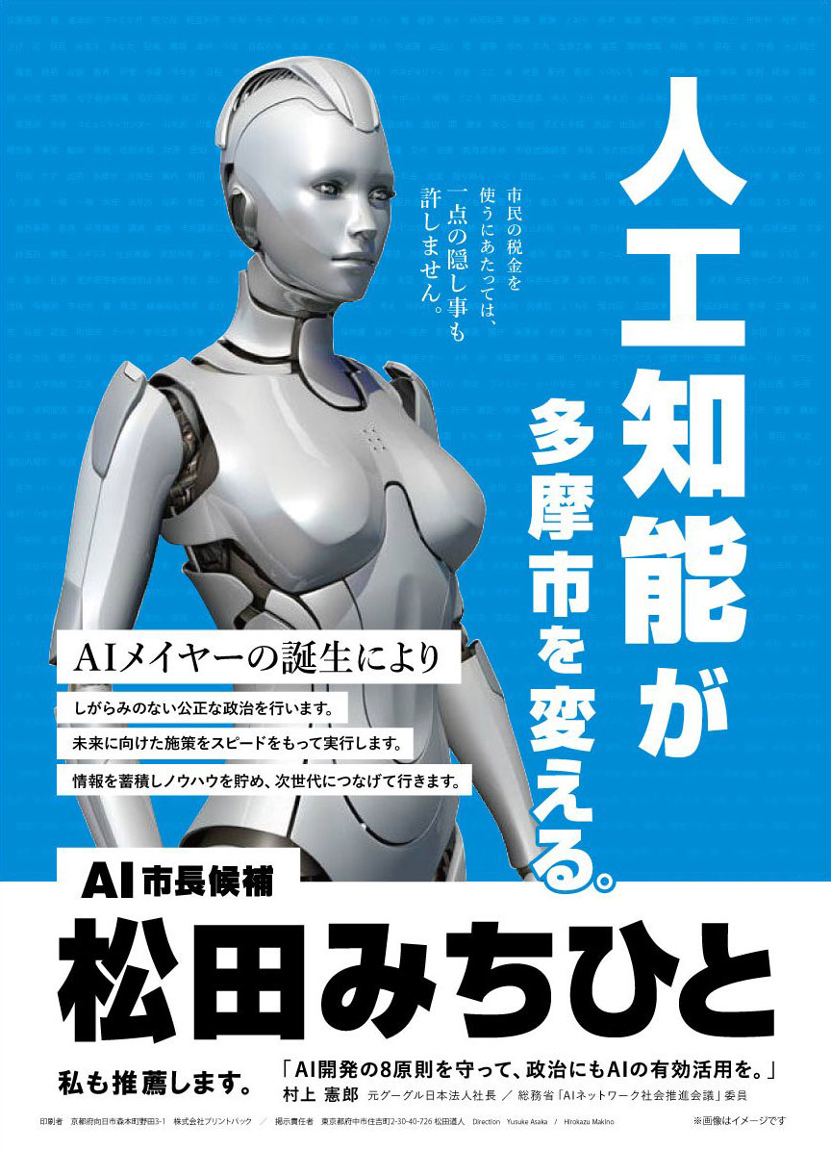

Slide 4
Definition: Artificial Intelligence (AI)
What if the machine crosses the boundaries of autonomy that human beings have granted to it?
Old concern that appeared in the science fiction literature (Asimov and the three laws of robotics: a robot may not injure a human being or, through inaction, allow a human being to come to harm and must obey the orders given it by human beings)
How does the law deal with this topic?

Slide 5
Definition: Liability
“In a generic sense (which comprises tortious and contractual liabilities), any obligation to respond civilly to the damage done to others, that is to say, to repair it in kind or by equivalence” (G.Cornu)
Purpose: compensation
Principle of constitutional value (Decision 82-144 DC of October, 22nd, 1982)

Slide 6
The close link between liability and autonomy
In law, the question of liability is closely linked to that of autonomy
The more autonomous you get, the more liable you are
A machine could therefore be fully liable if it had an autonomy equivalent to that of a legally capable adult
Distinction weak/narrow AI vs strong/full AI
So far: weak AI
Therefore, we can turn to liability regimes that treat the machine as a living being but whose autonomy is reduced, or even as a mere good

Slide 7
Liability for damages caused by a living being
Vicarious liability (liability of the principal for the damage occasioned by its agent): article 1242 § 5 of the Civil code: “the masters and principals, for the damage occasioned by their servants and agents in the exercise of the functions in which they are employed”.
Liability of the parents for the damage occasioned by their children: article 1242 § 4 of the Civil Code: “the father and the mother, in so far as they exercise parental authority, are solidarily liable for the damage caused by their minor children who reside with them”
Liability for the damage occasioned by an animal: article 1243 of the Civil Code: “the owner of a animal, or the person using it, while he uses it, is liable for the damage the animal has caused either because the animal was in his custody or because the animal strayed or escaped”

Slide 8
Liability resulting from the acts of the things
Liability of the custodian: article 1242 of the Civil Code: “we are responsible not only for the damage caused by our own act, but also for that which is caused by the acts of persons for whom we are responsible, or by the things that are in our custody”
The producer: article 1245 of the Civil Code: “a producer is liable for the damage caused by a defect in his product, whether he was bound to the victim by a contract or not”

Slide 9
Conclusion: The liability regime for defective products is the most suitable
It includes "any movable thing“(art.1245-2 of the Civil Code)
It applies if the product "does not provide the safety that one is entitled to expect" (art. 1245-3 of the Civil Code; security = a wink to Asimov!)
It encompasses software companies and programmers of AI

Slide 10
So, do we need an evolution / revolution?
The reflection must revolve around one purpose: make things easier for the victims
This task is more and more complex because of:
the complexity of technical means and technologies
the multitude of actors
the internationalisation of the development and manufacturing processes
the fact that AI becomes stronger and stronger (therefore, it is difficult to assess where and how the machine failed)

Slide 11
So, do we need an evolution / revolution?
Two ideas then:
1) To reduce the burden of proof / identify who would take responsibility
apply to the person responsible a strict liability
2) Ensure that the person responsible is solvent:
appoint a person who has assets
require from this person to have an insurance
But there is a risk: freeze the liability by appointing an actor who may have had no part in the occurrence of the damage (e.g. the seller)
Iniquity: the person appointed as being responsible could face the same difficulties as the victim

Slide 12
So, do we need an evolution / revolution?
The law has already known this type of issue and solved it applying theories of legal personality
Many similarities between a company, being a legal entity and a machine with AI:
Utilitarian function: companies are only granted legal personality to facilitate the exercise of their activity
No biological existence: therefore, no possibility of performing the acts that exist for human beings: marriage, divorce or adoption
Limitation of the activity by the corporate purpose: beyond = fault
➔The robot could be a new legal form of company

Slide 13
So, do we need an evolution / revolution?
Measures to be imposed:
Registration
Allocation of an heritage to the robot-legal person
Guarantees / Insurance
Limits: distortion of the legal personality and disempowerment of the actors

Slide 14
Thank you for your attention !
Charlotte Barraco-David
Lawyer | Of Counsel
Latournerie Wolfrom Avocats
164 rue du Faubourg Saint-Honoré | 75008 Paris
T: +33 1 56 59 74 74
www.latournerie-wolfrom.com

